Slide 1
DATA QUALITY
ISSUES
Data quality and errors – Sources of error in GIS – Finding and modeling errors of GIS – Managing GIS error

Slide 2
INTRODUCTION
Quality is a word in a dictionary define that ‘degree of excellence’.
In GIS, data quality is used to give an indication of how good data are.

Slide 3
INTRODUCTION
In many industries, quality control is everything.
GIS users strive for quality products from their systems.

Slide 4
INTRODUCTION
Errors can enter a GIS in many different ways.
For example:
A mistake in digitizing a field boundary.
A mistake in the transcription of a grid reference.
Misinterpretation of satellite imagery.

Slide 5
INTRODUCTION
But what is a high-quality product?
What exactly are good quality data?
How can we describe and recognize poor quality output?

Slide 6
INTRODUCTION
Two issues are:
First, the terminology, and
Second, the sources, propagation and management.
Describing data problems in GIS is difficult since many of the words used are also common in everyday language.
Words such as quality, accuracy and error not only mean different things to different people but also have precise technical definitions.

Slide 7
INTRODUCTION
The terms used for data error and quality are introduced to solve problems.
The types and sources of errors to recognize and deal with problems.

Slide 8
INTRODUCTION
Techniques for modelling and managing errors are.
A few data sets are error-free.
GIS users should document the limitations.

Slide 9
INTRODUCTION
Earlier in the book we compared the fuel in a car to data in a GIS.
In the same way that a poor quality fuel may cause problems with the running of the car, poor quality data will introduce errors into your GIS.

Slide 10
DESCRIBING DATA QUALITY AND
ERRORS
In GIS, data quality is used to give an indication of good data.

Slide 11
DESCRIBING DATA QUALITY AND
ERRORS
Issues such as error, accuracy, precision and bias can help to assess the quality.
In addition, the resolution and generalization.

Slide 12
DESCRIBING DATA QUALITY AND
ERRORS
A systematic error would have occurred.

Slide 13
DESCRIBING DATA QUALITY AND
ERRORS
Accuracy of reality.

Slide 14
DESCRIBING DATA QUALITY AND
ERRORS
Precision is the recorded.

Slide 15
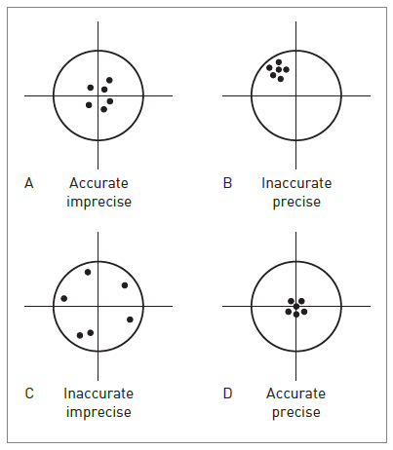
The difference between accuracy and precision is Shown:

Slide 16
DESCRIBING DATA QUALITY AND
ERRORS
Bias in GIS data is the systematic variation of data

Slide 17
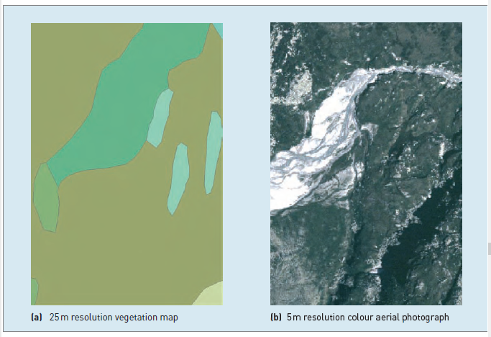
Resolution and generalization of raster datasets

Slide 18
DESCRIBING DATA QUALITY AND
ERRORS
Generalization is the process of simplifying the complexities.

Slide 19
DESCRIBING DATA QUALITY AND
ERRORS
Completeness, compatibility, consistency and applicability are introduced here.
A complete will cover period of interest.

Slide 20
DESCRIBING DATA QUALITY AND
ERRORS
Maps containing data measured in different scales of measurement cannot be combined easily.

Slide 21
DESCRIBING DATA QUALITY AND
ERRORS
Consistency applies not only to separate data sets but also within individual data sets.

Slide 22
SOURCES OF ERROR IN GIS
Spatial and attribute errors can occur at any stage

Slide 23
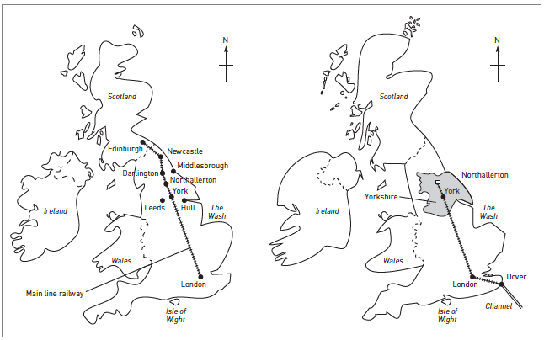
MENTAL MAPS

Slide 24
Errors arising from our understanding and modelling of reality
Our perception of reality influences our definition of reality.

Slide 25
Errors arising from our understanding and modelling of reality
Consider the problem of defining a common geographical feature such as a mountain in a GIS.

Slide 26
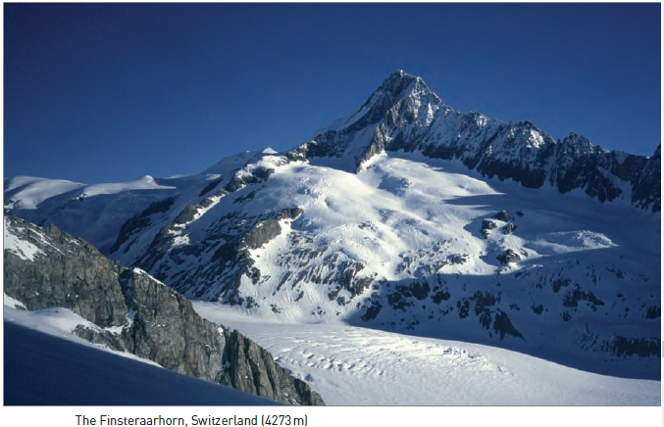
Finsteraarhorn, Switzerland (4273m)

Slide 27
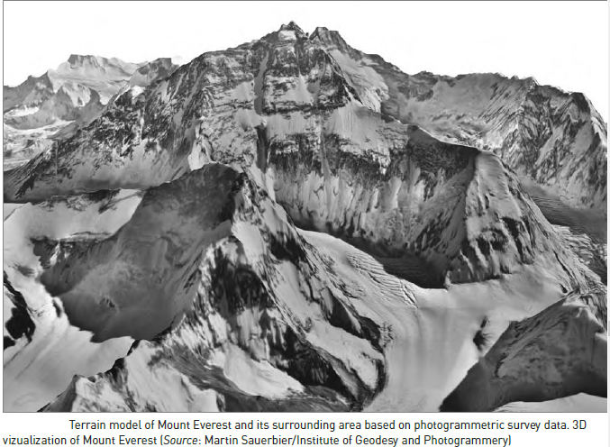
Terrain model of Mount Everest (8849 m)

Slide 28
Errors arising from our understanding and modelling of reality
The problem of identifying mountains.

Slide 29
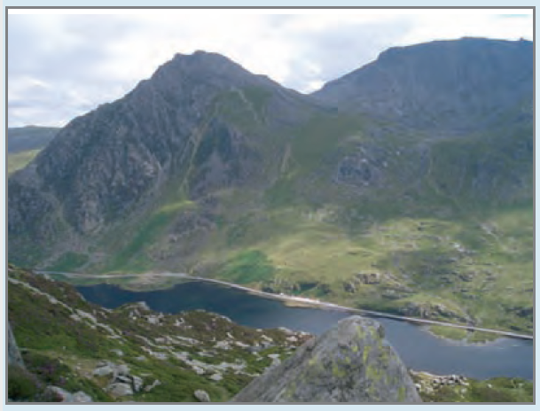
Visualize the problem for Tryfan; a mountain in north Wales.
Photograph of Tryfan

Slide 30
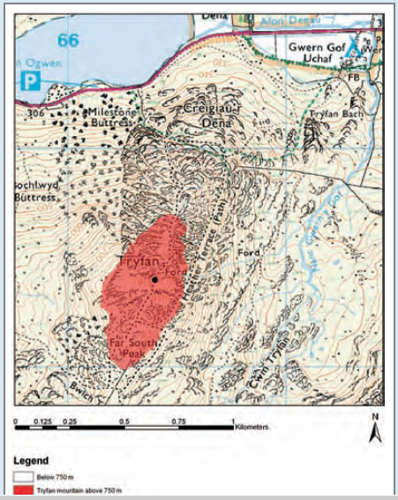
Ordnance Survey 1:50,000 topographic map showing area above 750m

Slide 31
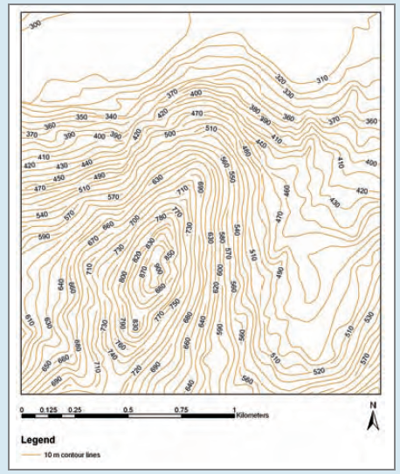
Contour map

Slide 32
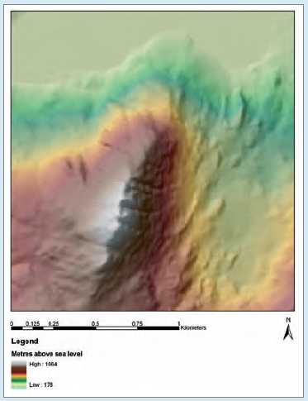
DEM Representation

Slide 33
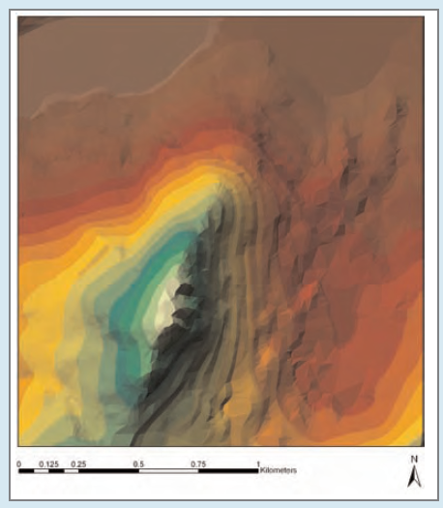
TIN Representation

Slide 34
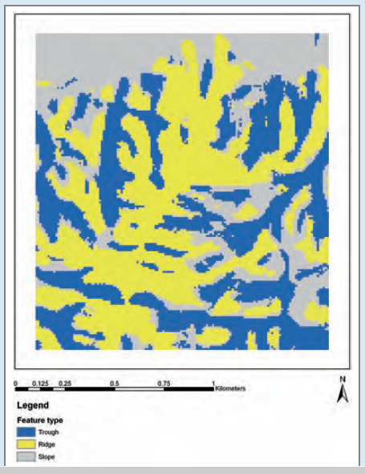
Topographic features

Slide 35
Errors in source data for GIS
All sources of spatial and attribute data are likely to include errors.

Slide 36
Errors in source data for GIS
Cartographic data sources error are:
  CONTINUOUS DATA
  FUZZY BOUNDARIES
  MAP SCALE
  MAP MEASUREMENTS

